Slide 2
MongoDB

Slide 3
Features Highlight
Written in C++, current stable version 2.2.2
Document Oriented DB (BSON)
Expressive query language
Full index support
Atomic writes per document
Fast In-Place Updates
Replica Sets & Auto Sharding
No support for joins
No native transactions support

Slide 4
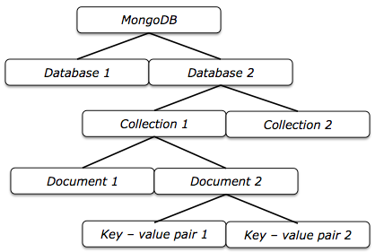
Single Node Architecture

Slide 5
Document Structure
BSON Documents
Like JSON but binary format
Size Limit 16Mb per doc (if not enough => GridFS)
Flexible Schema
Collections do not enforce document structure
Common fields in a collection's document may have different data type
Notes:
GridFS: Instead of storing a file in an single document, GridFS divides a file into parts, or chunks, [1] and stores each of those chunks as a separate document. By default GridFS limits chunk size to 256k. GridFS uses two collections to store files. One collection stores the file chunks, and the other stores file metadata.

Slide 6
Data Modeling Decisions
Embed sub documents
Less expensive than querying multiple documents
Better performance for reads
Still efficient writing thanks to fast in place updates
Reference sub documents
Manual References
DBRef
Atomicity
atomic operations on a single document
Notes:
Fast in-place updates: No need to rewrite the whole doc when updating only some fields.

Slide 7
Data Modeling Decisions
Data lifecycle management
Time To Live (TTL) collections (ie: sessions)
Capped collections (ie: logs)
Large Number of Collections
Minimum overhead for each collection
Increase throughput batch processing
Warning: Limit on size of namespace files (2Gb)
Notes:
TTL collections: each doc as an expiration date
Capped collection: collection has a maximum quantity of Docs (FIFO)
Large number of collections: ie. have logs.dev, logs.debug, etc instead of only one log collection

Slide 8
Data Modeling Decisions
Indexes
Automatic index on each _id field
Each index requires at least 8KB of data space
Indexes has some negative performance on writes
Mongo uses one index per query/$or clause
Compound Indexes
Covered Queries (exceptions array fields)
Choose index/queries to ensure selectivity
Index to sort query results
Ensure indexes fit RAM
Notes:
Write performance: MongoDB must update all indexes associated with a collection after every insert, update, or delete operation.
Compound Indexes: index on multiple fields. Mongo will not use the index if there are fields in the query that are not in the compound index. Remember that will use one index per query/ $or clause
Covered Queries: Is a query in which all the queried fields are part of an index. Querying only the index is much faster than querying documents. Index keys are typically smaller than the documents they catalog, and indexes are typically stored in RAM or located sequentially on disk.
Ensure Selectivity: Use indexes/queries to restrict the number of docs to be process after using the index. http://docs.mongodb.org/manual/applications/indexes/#create-queries-that-ensure-selectivity
Text Indexes for full text search: just released in testing versions

Slide 9
Data Modeling Patterns & Examples
Model Embedded One-to-One Relationships Between Documents
Model Embedded One-to-Many Relationships Between Documents
Model Referenced One-to-Many Relationships Between Documents
Model Data for Atomic Operations
Model Tree Structures with Parent References
Model Tree Structures with Child References
Model Tree Structures with Materialized Paths
Model Tree Structures with Nested Sets
Notes:
Examples taken from the mongoDB official documentation

Slide 10
CRUD Operations
Create
.insert(<d> || [<d>]) single/bulk creation
Create/Update
.update(<query>,<update>,{upsert:true})
.save(<d>) if _id is not present/exist => inserts
.findAndModify(<options>) atomic test and update
Read
.find(<query>,<projection>) return a cursor
.findOne(<query>,<projection>) return a doc
Delete
.remove(<query>,<justOne>) justOne === LIMIT 1
Notes:
findAndModify useful to create kind of transactions

Slide 11
Operators
Query operators
Comparison: $all, $gt, $gte, $in, $lt, $lte, $ne, $nin
Logical: $and, $nor, $not, $or
Element: $exists, $mod, $type
Javascript: $regex, $where
GeoSpatial: $box, $near, $within for shapes
Array: $elemMatch, $size
Projection operators
$elemMatch, $slice
Notes:
Full reference: http://docs.mongodb.org/manual/reference/operators/

Slide 12
Operators
Cursors operations
.hasNext(), .next(), .forEach(), .map(), .limit(), .skip(), .sort(), .count(), .group(), .aggregate(), .mapReduce()
Update Operators
Fields: $inc, $rename, $set, $unset
Array: $, $addToSet, $pop, $pullAll, $pull, $pushAll, $push
Extra: $bit, $isolated
Notes:
Full reference: http://docs.mongodb.org/manual/reference/operators/

Slide 13
CRUD Examples
db.bios.insert({ name: { first: 'John', last: 'McCarthy' }, birth: new Date('Sep 04, 1927'), death: new Date('Dec 24, 2011'), contribs: [ 'Lisp', 'Java, 'ALGOL' ], awards: [ { award: 'Turing Award', year: 1971, by: 'ACM' }, { award: 'Kyoto Prize', year: 1988, by: 'Inamori Foundation' } ] } )

Slide 14
CRUD Examples
db.bios.find( {
_id: {
$in: [ 5, ObjectId("507c35dd8fada716c89d0013") ]
}
})
db.bios.find({ awards: { $elemMatch: { award: 'Turing Award', year: { $gt: 1980 } } }
})
Notes:
db.bios.find({ "awards.award": { $regex: "^Turing*"}})

Slide 15
CRUD Examples
db.bios.update( { _id: 1 }, { $set: { 'name.middle': 'Warner' }, $push: {
awards: {
award: 'IBM Fellow',
year: 1963,
by: 'IBM'
}
} })

Slide 16
No Native Transactions: Alternatives
Ensure old data in the query of the update
var myDocument = myCollection.findOne( { sku: 'abc123' } );
var oldQty = myDocument.qty;
var factor = myDocument.qty < 20 ? 3 : 2;
myDocument.qty *= factor;
myCollection.update({
_id: myDocument._id,
qty: oldQty
}, {
$set: { qty: myDocument.qty }
})

Slide 17
No Native Transactions: Alternatives
Isolated query and modify operations
db.product.findAndModify( {
query: { name: "Bag", qty: { $gt: 0 } },
update: { $inc: { qty: -1 } }
});
Isolated writes in the same collection
db.foo.update(
{ field1 : 1 , $isolated : 1 },
{ $inc : { field2 : 1 } },
{ multi: true }
);
Notes:
The $isolated isolation operator does not provide “all-or-nothing” atomicity for write operations.

Slide 18
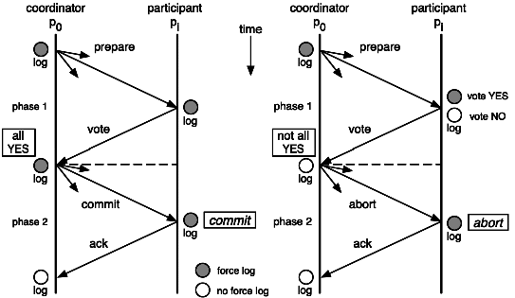
No Native Transactions: Alternatives
Two-Phase Commit
Notes:
Two Phases Commit References:
http://en.wikipedia.org/wiki/Two-phase_commit_protocol
http://proton.inrialpes.fr/~krakowia/MW-Book/Chapters/Transact/transact-body.html

Slide 19
Aggregation Framework
Alternative to MapReduce, added in v2.1
Useful for (not so) simple aggregation queries
Concepts:
Pipelines: $project, $match, $limit, $skip, $unwind, $group, $sort
Expressions: $first, $last, $max, $min, $avg, $sum, $addToSet, .........
Notes:
Pipelines -> Map
Expressions -> Reduce

Slide 20
Aggregation Framework
Early filtering + index for boosting performance
Compatible with sharded collections
Limitations:
Cannot operate on certain Data Types Binary, Symbol, MinKey, MaxKey, DBRef, Code, CodeWScope
Output from pipeline can contain only 16Mb
Any single aggregation operation cannot consumes more than 10% of system RAM

Slide 21
Aggregation Examples
db.articles.aggregate( { $project : { author : 1, tags : 1, }}, { $unwind : "$tags" }, { $group : { _id : { tags : "$tags" }, authors : { $addToSet : "$author" } }});
db.article.aggregate( { $group : { _id : "$author", docsPerAuthor : { $sum : 1 }, viewsPerAuthor : { $sum : "$pageViews" } }});

Slide 22
MapReduce
Handle complex aggregation task
Output the result into a new collection
If the out collection exists a merge will be performed
Allow incremental MapReduce
Uses temporary collections during process. It is possible to run again the command without waiting to finish it
Notes:
Incremental MapReduce: make the first MapReduce to a collection, and keep running the command over and over only matching the new documents and outing to the same collection

Slide 23

Signature MapReduce
db.collection.mapReduce( <mapfunction>, <reducefunction>, { out: <collection>, query: <document>, sort: <document>, limit: <number>, finalize: <function>, scope: <document>, jsMode: <boolean>, verbose: <boolean> } )

Slide 24
Example MapReduce
var mapFunction1 = function() { emit(this.cust_id, this.price);
};
var reduceFunction1 = function(keyCustId, valuesPrices) { return Array.sum(valuesPrices);
};
db.orders.mapReduce( mapFunction1, reduceFunction1, { out: "map_reduce_example" });

Slide 25
Replica Sets
Cluster of two or more mongod instances
One designed as Primary, receives all the writes
Data is async replicated to Secondaries (opLog)
Automated failover and Primary election
Driver knows who is the Primary and how to elect a new one based on the Secondaries votes

Slide 26
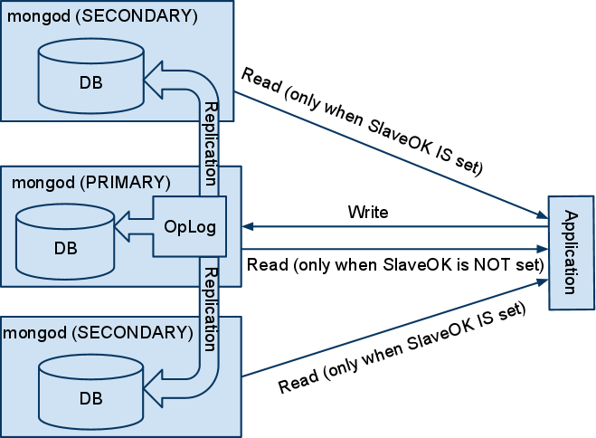
Replica Sets

Slide 27
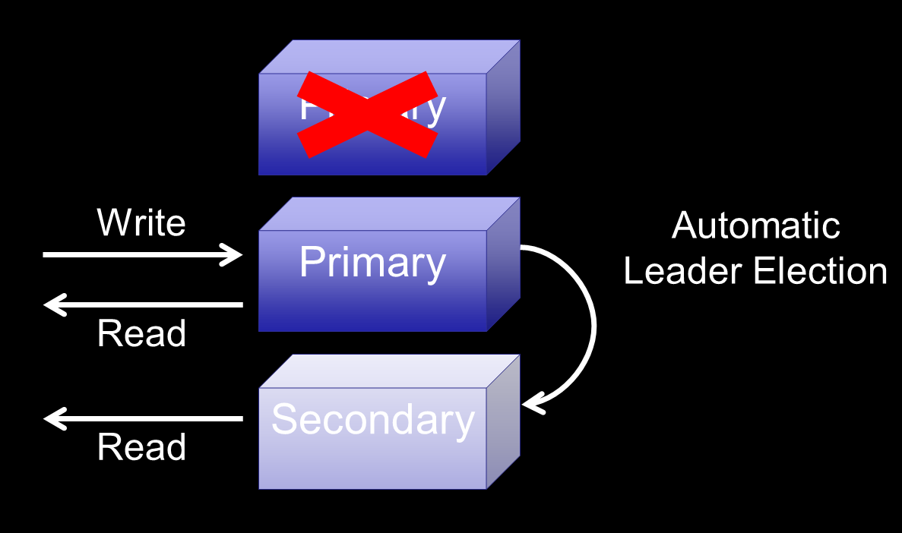
Replica Sets
Notes:
Secondaries votes, but driver decides and knows the Primary.

Slide 28
Replica Sets - Secondary Types
Secondary-Only: Cannot become primary under any circumstance
Hidden: Invisible to client applications
Delayed: Apply operations from the primary’s oplog after a specified delay (rolling backup)
Arbiters: These members have no data and exist solely to participate in elections
Non-Voting: Do not vote in elections. Are only used for larger sets with more than 12 members.

Slide 29
Write Concern & Replica set
Confirms the success of write operations to a mongod instance through getLastError()
Errors Ignored
Unacknowledged
Acknowledged
Journaled
In replica set's extra parameter to get confirmation of the replication, w param of getLastError() indicating how many nodes to wait
Notes:
unacknowledged: MongoDB does not acknowledge the receipt of write operation as with a write concern level of ignore; however, the driver will receive and handle network errors, as possible given system networking configuration. Before the releases outlined in Default Write Concern Change, this was the default write concern.
receipt acknowledged: The mongod will confirm the receipt of the write operation, allowing the client to catch network, duplicate key, and other exceptions. After the releases outlined in Default Write Concern Change, this is the default write concern. [1]
journaled: The mongod will confirm the write operation only after it has written the operation to the journal. This confirms that the write operation can survive a mongod shutdown and ensures that the write operation is durable.

Slide 30
Read Preferences
How clients route read operations to a replica set (configurable even per query)
primary: strict consistency / no failover / slow
primaryPreferred: strict consistency / slow
secondary: eventual consistency / no failover /fast
secondaryPrefered: eventual consistency / fast
nearest: eventual consistency / low latency
Tag Sets:
Specify custom read preferencies to reach specific members
Notes:
Combinate write concerns and read preferences for each architecture and use case for expected/tolerated results on distributed environments

Slide 31
Sharded Collections
Distribute a collection among nodes (shards)
Use a shard key to partition the collection
Need config server and mongos server to route the queries
Queries are processed in each shard
Automatically balances data and load
Add write capacity by distributing load
Increase the potential amount of data.

Slide 32
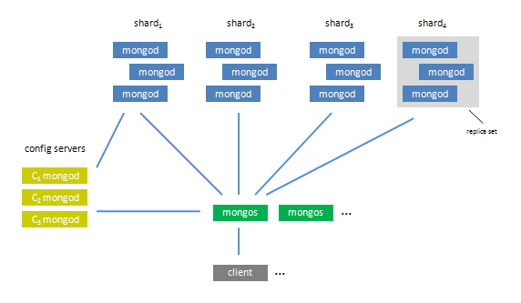
Sharded Collections
Notes:
Shards. Each shard is a separate mongod instance or replica set that holds a portion of the your database collections.
Config servers. Each config server is a mongod instances that holds metadata about the cluster. The metadata maps chunks to shards.
mongos instances. The mongos instances route the reads and writes to the shards.

Slide 33
Ideal Shard Key
Easily divisible: Shard keys that have a limited number of possible values are not ideal as they can result in some chunks that are “unsplitable.”
Distribute write operations: prevent any single shard from becoming a bottleneck.
Mongos should return most query operations directly from a single specific mongod instance.
Notes:
Choosing the correct shard key can have a great impact on the performance, capability, and functioning of your database and cluster. Appropriate shard key choice depends on the schema of your data and the way that your application queries and writes data to the database.
The ideal shard key:
is easily divisible which makes it easy for MongoDB to distribute content among the shards. Shard keys that have a limited number of possible values are not ideal as they can result in some chunks that are “unsplitable.” See the Cardinality section for more information.
will distribute write operations among the cluster, to prevent any single shard from becoming a bottleneck. Shard keys that have a high correlation with insert time are poor choices for this reason; however, shard keys that have higher “randomness” satisfy this requirement better. See the Write Scaling section for additional background.
will make it possible for the mongos to return most query operations directly from a single specific mongod instance. Your shard key should be the primary field used by your queries, and fields with a high degree of “randomness” are poor choices for this reason. See the Query Isolation section for specific examples.

Slide 34
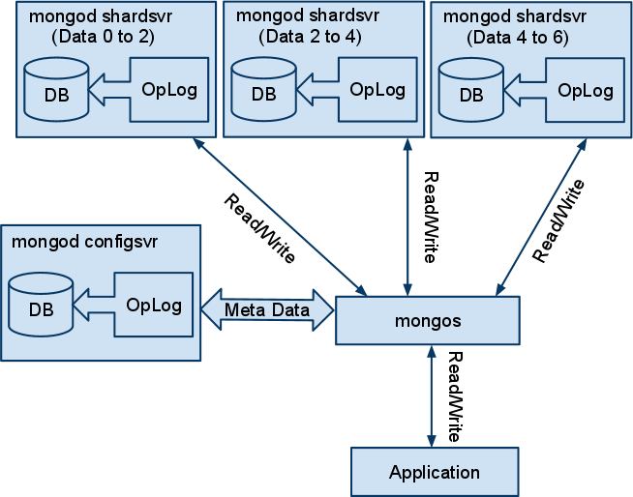
Sharded Collections - Write capacity

Slide 35
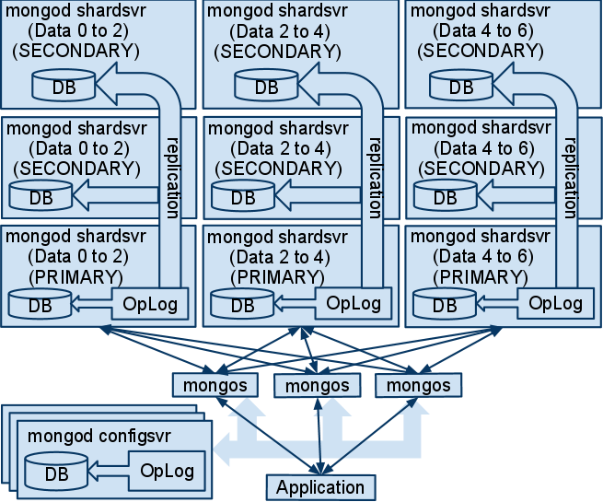
Distributed Examples
Notes:
http://www.catify.com/2010/11/22/mongodb-infrastructure-tests-part-ii-produktion-ready-sharding/
http://sett.ociweb.com/sett/settAug2011.html

Slide 36
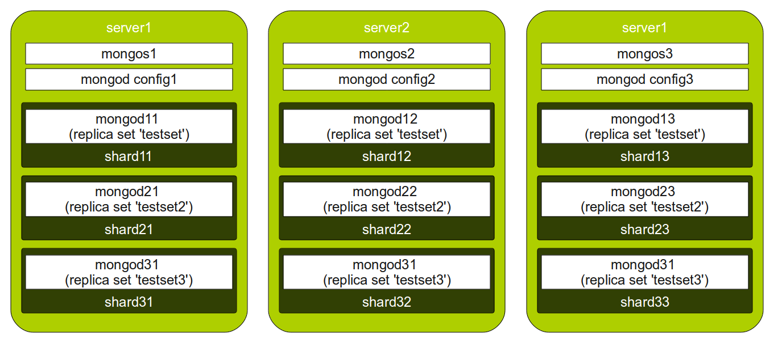
Distributed Examples
Notes:
http://www.catify.com/2010/11/22/mongodb-infrastructure-tests-part-ii-produktion-ready-sharding/
http://sett.ociweb.com/sett/settAug2011.html

Slide 37
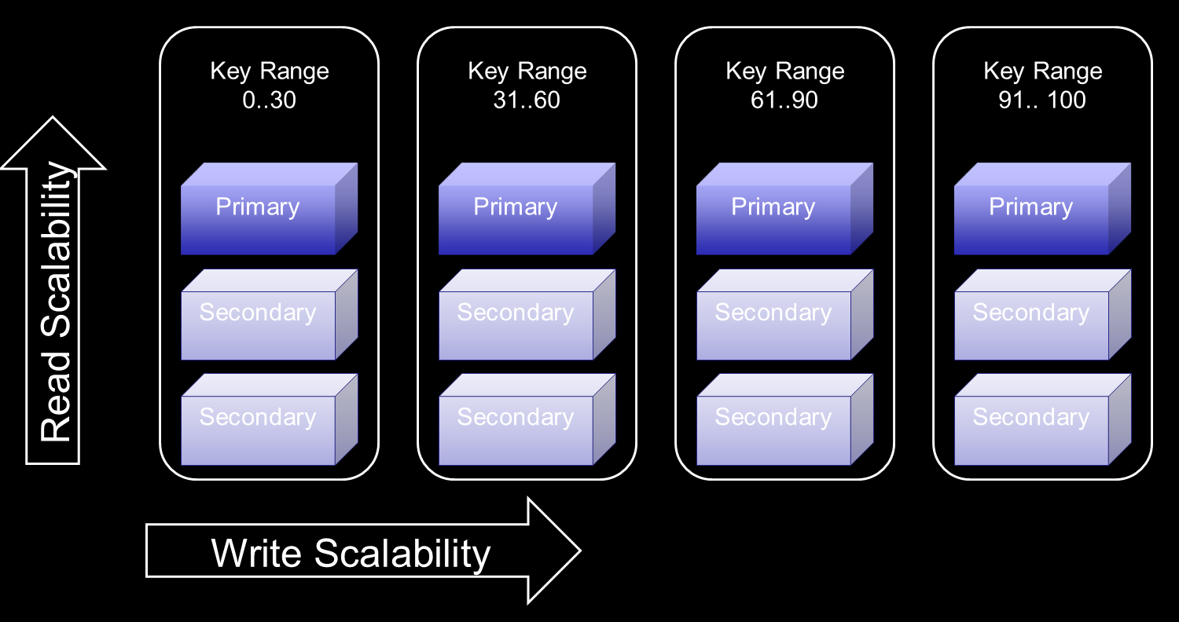
Replica Sets + Sharded Collections

Slide 38
Conclusions
PROS:
General purpose DB
Very flexible data model
Replication & Sharding out of the box
Many tools for scaling out
Many drivers on different languages
CONS:
App code must handle complex logic for scaling
Still work in progress

Slide 39

References
Home Page
http://www.mongodb.org/
Fundamentals FAQ
http://docs.mongodb.org/manual/faq/fundamentals/
Manual:
http://docs.mongodb.org/manual/
http://docs.mongodb.org/master/MongoDB-Manual.pdf

